Slide 1
Engineering
Induction Training Program
(E-ITP)
Project Management
Part 2

Slide 2
Topics
Project Planning
Plan Creation
Estimation

Slide 3
Project Planning

Slide 4
Project Management Process
Define Scope
& Commit
Organization
Project Initiation & Start-up
Project Planning & Team Formation
Project Tracking & Control
Project Delivery & Support
Develop Plan
Execute Plan
Track and
Control
Deliver
Product and
Close Project

Slide 5
Project Planning and Team Formation
Project Definition
Plan Creation
Project infrastructure
Team formation
Major activities
Key project documents
Project plan sign-off

Slide 6
Project Definition
Problem / Opportunity Statement
Project Mission / Goal
Project Objectives
Success Criteria
Assumptions, Risks, Obstacles

Slide 7
Project Mission Statement
What do we do ?
For whom do we do it ?
How do we go about it ?

Slide 8
Project Objectives
Each Objective should be:
  Critical
  Observable
  Distinguishable
  Measurable

Slide 9
Plan Creation

Slide 10

What is the project plan ?
A plan is to a project what a route map
is to
a journey

Slide 11

The Project Plan provides a standard communication tool through out the life cycle of the project
Project Plan
Customer
Supporting Departments
Project
Team
Senior Management

Slide 12
What is the project plan?
The Project Plan documents:
  What to do ?
  When to do ?
  How to do ?
  Who is to do ?

Slide 13
Project Infrastructure
Projects need to start with a basic and supporting infrastructure including:
  Configuration management:
    e.g., a Versioned Object Base (VOB)
  Project folder
  Project mailing list
  Project Web site
  Tools acquisition and installation

Slide 14
Team Formation
Members
  Initial members
  Engineers moved from other projects
  Newly hired engineers
Roles assignment
  PM,TL,CM,TE,SE,QE, SETE, etc.
Team formation requires...
  Adjusting to the working environment
  Learning to work with new team members
  Sharing and contributing to project objectives
  …facilitate and drive the team’s Commitment to project success...

Slide 15
Elements of an
Effective Commitment Process
The person making the commitment does so willingly
The commitment is not made lightly; that is, the work involved, the resources, and the schedule are carefully considered
There is an agreement between the parties on what is to be done, by whom, and when
The commitment is openly and publicly stated
The person responsible tries to meet the commitment, even if help is needed
Prior to the commitment date, if it is clear that it cannot be met, advance notice is given and a new commitment negotiated
  Watts S. Humphrey

Slide 16
Major Planning Activities
Deploy the project infrastructure and development environment
Ensure appropriate training
  General training
  Role-based training
  Domain-specific training
Produce key planning documents as well as artifacts such as:
  Work Breakdown Structure
  Estimates
  Schedule

Slide 17
Key Project Planning Documents
REQB - Requirement Book
  (or Statement Of Work)
SPMP - Project Management Plan
SQAP - Quality Assurance Plan
SCMP - Configuration Management Plan
MBOOK - Metric Book
Project Folder
REQB + SPMP forms the virtual “contract” between the Center and the customer...

Slide 18
Key Project Documents: REQB
The document may contain:
  Summary of Requirements
  System Architecture
  System Integration and Testing Strategy
  Development Environment Requirements
  Target Environment Requirements
  Testing Environment Requirements
  Training Requirements
  Maintenance Policy
  Quality Requirements
  Technical Risks and Risk Abatement Procedures
  Traceability Matrices
  List of Deliverables to the Customer

Slide 19
Work Breakdown Structure (WBS)
A hierarchical arrangement of elements of activity from which project estimates can be determined
A tool for planning, managing and reporting on a project
A tool for separating elements of a project for contractual/financial purposes or separating areas of responsibility

Slide 20
Types of Work Breakdown Structure
Product Breakdown
Work Breakdown
Organizational Breakdown
Phase Breakdown

Slide 21
Product Breakdown
Identifies features or components of the product or service which need to be developed during the project
Based upon the functionality or architecture resulting in units of work for the project
Subsystem
X
Feature
A
Feature
B
Feature
C
Feature
D
Component
W
Component
W
Component
W
Component
W
Component
W
Component
W
Component
W
Component
W
Component
W

Slide 22
Work Breakdown
Identify activities which need to be performed during the project
6.0 Module A Integration Test
6.1 Qualify submitted modules for integration
6.2 Check-in all code submittals
6.3 Validate build strategy
6.4 Perform parallel builds
6.5 Ramp Test Platform HW
6.6 Ramp Test Platform SW
6.7 Run Tests
6.8 ….
6.n

Slide 23
Organizational Breakdown
Identify Customer Organization & Roles
Identify Other Contractors e.g. Consultants, Vendors, etc.
Identify elements of your own organization participating in the project
Subsystem
X
On-site
Customer
Team
Project
Planning
Center
Team
A
Contractor
B

Slide 24
Phase Breakdown
If a developmental lifecycle model is used, a phase-wise breakdown can be made
Example:
  System Requirements
    Collect Preliminary Requirements
    Analyze Requirements
    Document Preliminary SRS
    Inspect SRS
    Baseline Requirements
  Preliminary Design
    Document Architecture
    …...

Slide 25
Using Breakdown Structures
Project Leader decides on the architectural approach and level of detail of the WBS
Noun-type approach identifies items
  call processor, detailed design
Verb-type approach identifies work
  plan, document
Other approaches may utilize organizational or even geographic decompositions
  marketing bid process, quality release criteria
  department, software center
Well defined WBS is good for planning, reporting, etc.

Slide 26
WBS Completion Criteria
WBS elements (tasks) are measurable
Start / End Events are clearly defined
Each “activity” has a deliverable
Time / cost can be estimated
Activity durations can be made within acceptable limits
Work assignments can be independent
R. Wysoki, 1995

Slide 27
Estimation
What gets estimated...
Some Problems encountered
Policies and Practices
Use of Historical Data
One method… Wide Band Delphi

Slide 28
What Gets Estimated
Estimation may include:
  Product Size (documents, Lines of Code, etc)
  Effort Required (working day/week/month/year)
  Schedule Required (e.g. resource/dependencies)
  Resources Required and Available
  Cost ($$ at management level)
  Anything else that might be relevant....
In other words: Estimate Everything… everything is an estimate (until the project is finished)!

Slide 29
Estimation Problems (1)
“Estimation is concerned with the prediction of uncertainties. It is more dignified than fortune telling, though not always more accurate....”

Slide 30
Estimation Problems (2)
Example: a DoD contractor
  Bid for contract (80 work years quote)
  Contract awarded, planning started
  Calculations showed 120 work years estimate
  50% budget overrun, $4,000,000 extra costs
  DoD did not accept new quote (legal action!)
  Super team of the best engineers was established to try to minimise the schedule overrun and loss
  The project eventually took only 60 work years

Slide 31
Estimation Problems (3)
Software estimates depend on:
  the people who do the work (skills/experience)
  the kind work performed (the product)
  the information that is available (historical data)
The estimation paradox:
  “Accurate estimates are generally required prior to getting the information needed to make the estimates”

Slide 32
Estimation Problems (4)
Why is it hard to estimate software projects?
  Requirements change
  Platforms and tools/technologies change
  Historical is data not available or not relevant
  Don’t know project nature until after analysis
  Some costs unrelated to code size (quality, usability, reliability, performance, management, etc)
  Dependencies on customer/contractor/support

Slide 33
Causes of Variation in Estimation
Variation in skill levels
  of the estimator, of the development team members, etc.
Unexpected events (Murphy’s Law)
Efficiency of Work Time
  how long is a day… interuptions, etc.
Mistakes and misunderstandings
  happen to everyone all the time
We do not really know what factors will be operative when work is underway on a task… we narrow the variance by sufficiently defining the activity...

Slide 34
A Center Estimation Policy
POLICY:
  “a minimum of two (documented) estimation methods shall be used for any software project”
  ….using more than one method to validate estimates is good practice…
POLICY:
  “re-estimation shall take place at relevant points throughout the project lifecycle (as documented in the SPMP)”
  ….the SPMP can document rules concerning when to re-estimate (and replan) …

Slide 35
Example Estimation Practices
Provide “rough” estimates before a quote (Memorandum Of Understanding - MOU)
Start “formal estimation” after Project Kick-Off
Estimate the project in stages, e.g.,
  in Requirements Analysis estimate Design
  in Design estimate Testing
Use historical data from previous/similar projects
Model and fast-prototype to obtain data
Use of expert opinion in Wide Band Delphi
Use of estimation tools (e.g., COCOMO)

Slide 36
Historical Data for Estimation
Stored in a database, repository, folder, etc.
May come from...
  previous project experience
  personal process metrics
Examples:
  Hours per page to create or review documents
  LOC per week (productivity)
  Number of problem reports per month or phase
  % of working week spent on actual project work

Slide 37
Methods of Estimating
By similarity…. Experience
With historical data
By expert advice
By Delphi
  a group technique to extract knowledge
3-point techniques (3 passes…)
  collect and compare an optimistic, pessimistic and “most likely” estimate
Combine Delphi and 3-point with the Wide-Band Delphi technique

Slide 38
Wide-Band Delphi Procedure
Distribute WBS to “experts” for preparation
Experts make their individual estimates for the average/min/max for each WBS item
Tabulate individual estimates average/min/max for each WBS item
Discuss assumptions/motivations for individual estimates until agreement is reached
Estimate the amount of work, not the schedule! (record schedule issues during the meeting)

Slide 39
Guidelines for Estimation
Make sure the data is relevant
Obtain background (project profile) information
Make sure everybody uses the same units
Use lines of code, not assembler equivalent lines as size indicator
Know the accuracy of the estimate
Document all assumptions

Slide 40
Key Project Documents: SPMP
Lifecycle Model & Process Tailoring
Organisational Boundaries and Interfaces
Project Responsibilities and Escalation Procedures
Management Objectives and Priorities
Defect Prevention Plan
Assumptions, Dependencies and Constraints
Risk Management
Staffing and Training Plan
Methods, Tools and Techniques
Work Packages and Dependencies
Resource Requirements and Allocation
Schedule

Slide 41
Schedule
Determines which tasks
  must be done sequentially
  can be done in parallel
Applies the estimated time required for tasks
Usually represented graphically by
  Gantt Chart
  Pert Chart

Slide 42
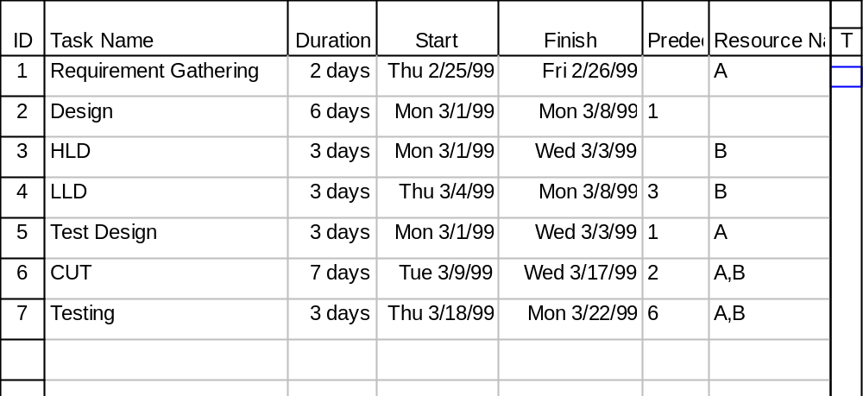
Scheduling
The WBS...

Slide 43
Scheduling - the Gantt Chart
The Gantt Chart is a bar chart
Length of bars are proportional to duration
Useful for understanding the set of tasks to be done at a specified time
Useful for tracking
Not good in showing task dependencies

Slide 44
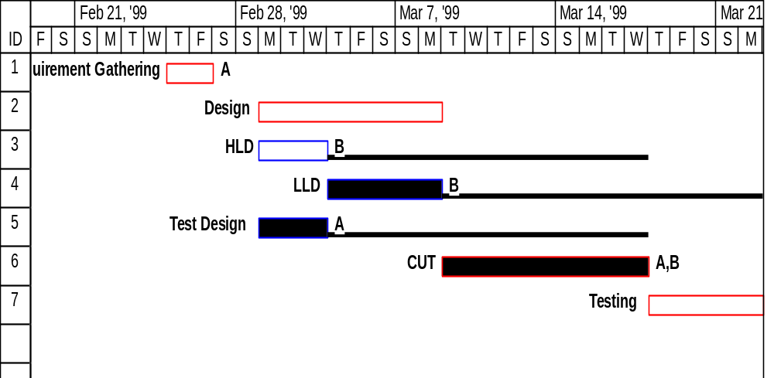
Scheduling - the Gantt Chart

Slide 45
Scheduling - the PERT Chart
PERT Chart is a network diagram (like the CPM chart)
The PERT shows all tasks and their relationships (dependencies)
Useful in understanding when the set of tasks to be done can be completed
Useful in showing task dependencies
Not good for use in tracking

Slide 46
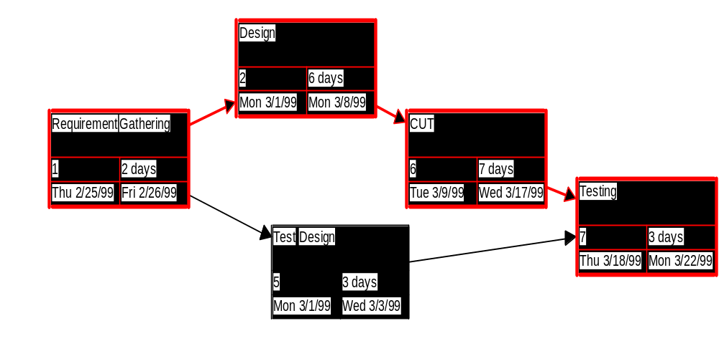
Scheduling - the PERT

Slide 47
Key Project Documents: SQAP
Project goals
  Product goals
  Project goals
    Project goals setting
    Should be measurable
    Should be challenging, but not unattainable
  Organizational goals
Project Metrics
  To be collected by the project
Audits
  Frequency

Slide 48
Key Project Documents: SCMP
Defines the Organization and Responsibilities
Configuration Manager role
Team SCM Responsibilities
Configuration Control Board
Software Configuration Identification
Configuration Control Procedures
Auditing, Traceability and Accounting
Tool conventions and methods
Interface Control
Archiving Requirements
Reporting

Slide 49
Key Project Documents: MBOOK
Defines and contains:
Project metrics entries and summaries
  Data for all defined quality metrics
  Phase and end-of-phase data
  Quality Gate results and milestone data
  Change information
  Estimation data
MBOOK is updated regularly and at start and end of each phase

Slide 50
Key Project Documents: Project Folder
The master document for all project activity
All team members must be aware of its contents
May be hardcopy, softcopy, or mixture of both
A softcopy folder may contain pointers to files
May be multiple folders
Contains project meeting minutes
May be web-based project folders
  Significantly reduces hard copy
  Much more convenient to use
  Still may need physical folders to hold documents with “signatures”

Slide 51
Key Project Documents:
Project Plan Sign-Off
Sign-off is done at:
Project Plan Review
  yet another quality gate
  internal approval of all project plans
  Buy-in from Center management and all appropriate support functions
Management approval gates
  e.g., occurs prior to customer sign-off of the SPMP and REQB
Customer approval gates
  e.g., customer is provided with approved SPMP and REQB

Slide 52
Change History
Vers. A.1 July 2001
  New format and revision E-ITP PM Week 1 from prior source materials
Vers. A.2 31 August 2001
  Updated format and separated into 4 presentations

